Slide 1
Analysis of logistic regression results over banking dataset
- IMBA, 2ND YEAR - BUSINESS RESEARCH METHODS -
Sturzu Diana-Ioana
Vilcea Raluca-Florentina
Zaharia-Lupu Andreea Gabriela

Slide 2
Contents of this project
Here’s what you’ll find in this Python Project presentation:
Introduction - What we have analysed
Data analysis - The dataset with all the entries being defined
Data manipulation - How we convert the data for the specific analysis(regression)
Optimization - Here we analysed the most non-impactful data in order to remove it (for a better accuracy score)
Results - The actual values we obtained (for the Accuracy score)
Discussions - What do these results really mean?

Slide 3

Introduction
Dataset

Slide 4

Bank Marketing Data Set
In this study, we examined an open source dataset called the Bank Marketing Data Set.
The information is gathered through direct interaction with clients (typically through phone calls) in order to determine whether or not they will open a term deposit.
The goal of this research is to demonstrate that we can use logistic regression to create an accurate model for predicting the result.

Slide 5
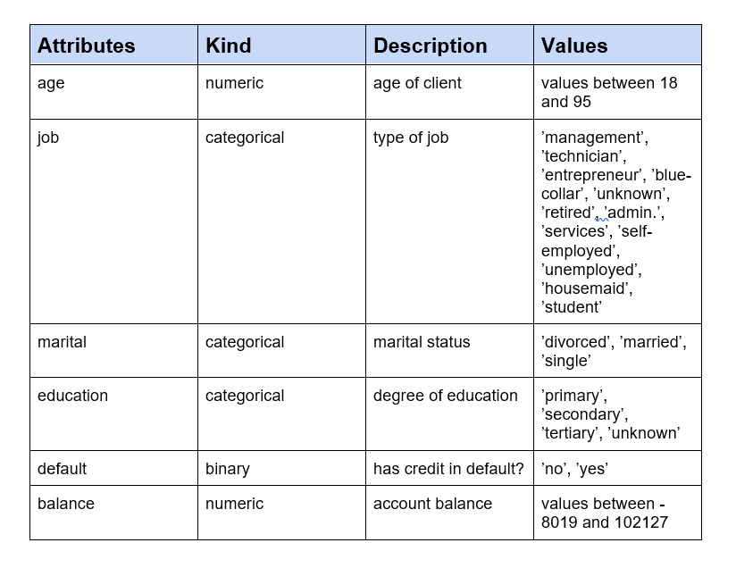
Data analysis
Data set values
The dataset has 45211 items with 17 columns that may be divided into 6 category features, 7 numeric features, and 4 binary characteristics, however the latter can alternatively be seen as categorical features.
The rest of the data can be found in the Word document.

Slide 6

Data manipulation
Converting the data:
For binary features we simply converted the series values from "yes" to "1" and the "no" to "2"
For categorical features we used the "get_dummies()" method from pandas library which creates a series for each categorical value.
After analyzing the variation of the mean for several categories, we chose to eliminate the "marital" one because it did seem to be that impactful.

Slide 7
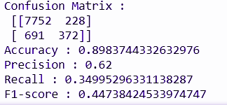
Logistic regression
Moving on to the next step, we have the results of the logistic regression without the removal of the irrelevant data.
A rate of accuracy of 89% - we outdid ourselves

Slide 8
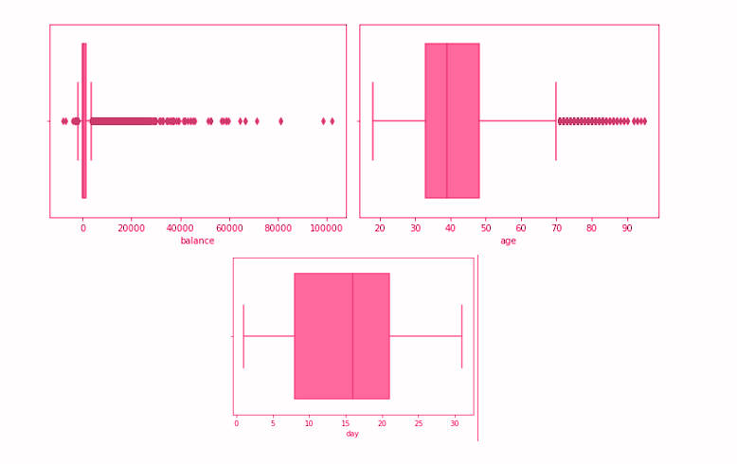
Optimization
To better visualise the outliers for some series we used a boxplot, which is a standardized way of displaying the distribution of data based on a five number summary.

Slide 9

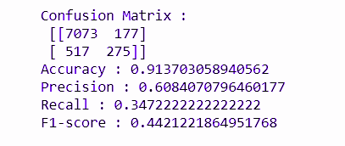
Removing the unnecessary data
For removing the outliers we calculated the z-score for the series that were most affected by outliers. By doing this, we removed around 5000 entries from our data set.
Moreover, we analyzed the p value for all the series.
A p-value less than 0.05 is statistically significant.
Thus we removed all the data that has a p-value higher than 0.05, and after this whole process we arrived at the following results:
We have reached an accuracy rate of 91% (even we didn’t expect this!).

Slide 10
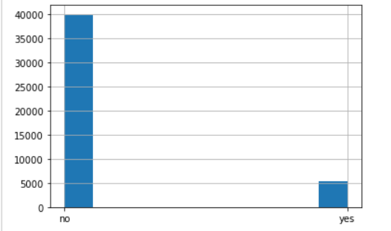
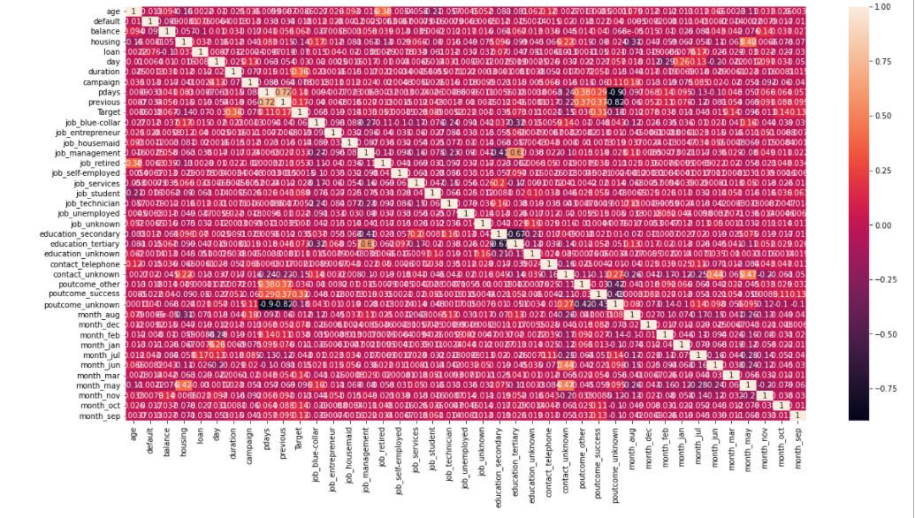
Results
Accuracy rate before the removal of the outliers - 89%
Accuracy rate after the removal of the outliers - 91%

Slide 11
Discussion
Correlation Matrix
What does that mean?
Positive relationship
If the correlation coefficient is high -> the variables have a positive influence on each other
We can take as an example the variable “Day” and “Campaign”
In the matrix - where they intersect - we have the value 0.16
We can notice that there was a strong connection between the campaign and the day/days in which it was conducted

Slide 12
Inspiration for this project
Here are all the links used when documenting for our project:
https://www.kaggle.com/prakharrathi25/banking-dataset-marketing-targets
https://datascience.quantecon.org/pandas/
https://datascience.quantecon.org/introduction/
https://datascience.quantecon.org/python_fundamentals/
https://datascience.quantecon.org/scientific/
https://towardsdatascience.com/building-a-logistic-regression-in-python-step-by-step-becd4d56c9c8
http://scikit-learn.org/stable/modules/generated/sklearn.linear_model.LogisticRegression.html
https://pandas.pydata.org/
https://www.w3schools.com/python/pandas/default.asp
https://pythonbasics.org/seaborn-boxplot/
https://towardsdatascience.com/beware-of-the-dummy-variable-trap-in-pandas-727e8e6b8bde
https://stackoverflow.com/questions/47388258/how-to-extract-the-regression-coefficient-from-statsmodels-api
https://www.youtube.com/watch?v=BMNuPwUD5EA
https://www.statology.org/z-score-python/
https://www.codegrepper.com/code-examples/python/sns+correlation+matrix

